Slide 2
Statistical(Machine) Learning Models
Edit by XuShen

Slide 3
Agenda
Measuring Performance in Regression Models
Linear Model: Ridge and Lasso Regression
Non-linear Model: SVM
Tree-based Model: Random Forest, Extra Trees, Gradient Boosting
Object-Oriented Programming
Stacking
Performance Metrics
Cross-Validation

Slide 4
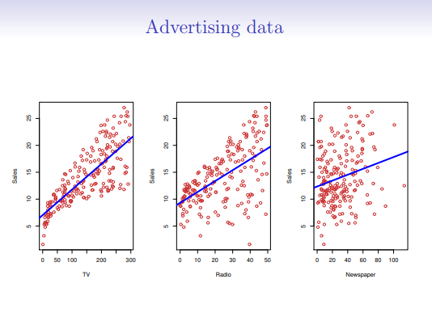
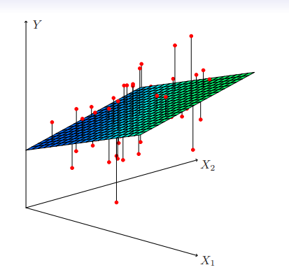
Ridge and Lasso Regression
What is linear regression? y=ax+b

Slide 5
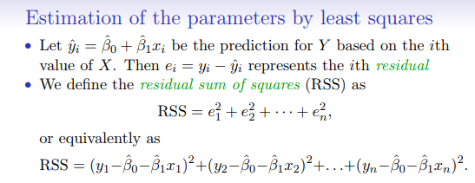
Ridge and Lasso Regression
Estimate the parameters by least squares

Slide 6

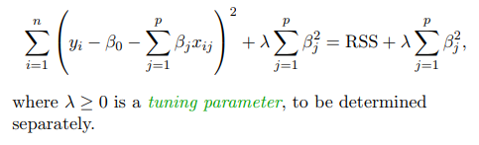
Ridge and Lasso Regression
Ridge regression: In linear regression, we minimize
In ridge regression, we minimize

Slide 7
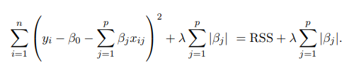
Ridge and Lasso Regression
In lass regression, we minimize
Ridge regression and lasso regression is a generalized form of linear regression

Slide 8
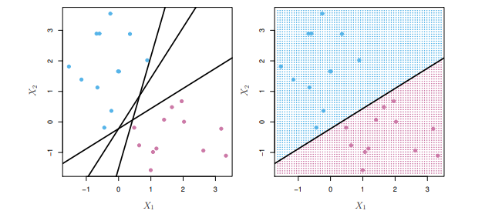
SVM(Support Vector Machine)
What is a hyperplane? A hyperplane in p dimensions is a flat affine subspace of dimension p − 1.

Slide 9
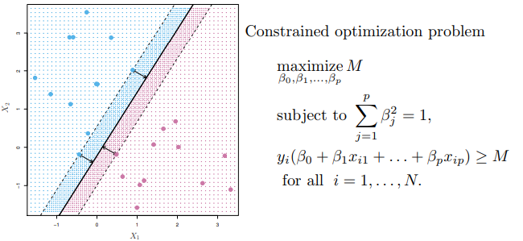
SVM(Maximal Margin Classifier)

Slide 10
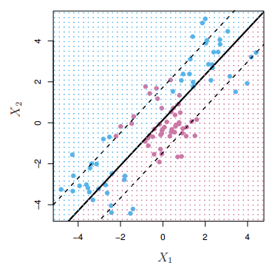
SVM(Maximal Margin Classifier)

Slide 11
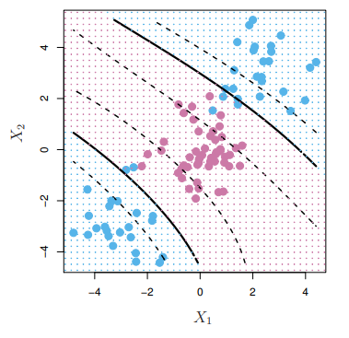
SVM(Maximal Margin Classifier)
We use feature expansion techniques(different kinds of kernels kick in)

Slide 12
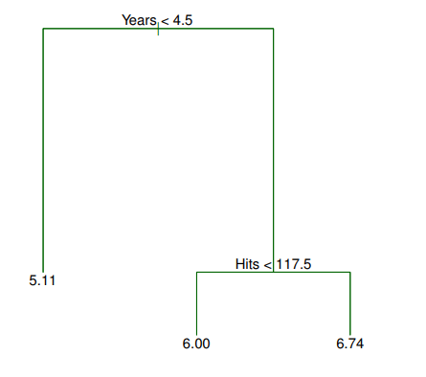
Random Forest
What is a basic decision tree?

Slide 13
Random Forest
What is a basic decision tree?

Slide 14
Random Forest
What is bagging?
We can bootstrap, by taking repeated samples from the (single) training data set.
In this approach we generate B different bootstrapped training data sets. We then train our method on the bth bootstrapped training set in order to get ˆf ∗b (x), the prediction at a point x. We then average all the predictions to obtain

Slide 15
Random Forest
Working mechanism of random forest
Random forests provide an improvement over bagged trees by way of a small tweak that decorrelates the trees. This reduces the variance when we average the trees.
• As in bagging, we build a number of decision trees on bootstrapped training samples.
• But when building these decision trees, each time a split in a tree is considered, a random selection of m predictors is chosen as split candidates from the full set of p predictors. The split is allowed to use only one of those m predictors.

Slide 16
Gradient Boosting
What is boosting?
Boosting works in a similar way, except that the trees are grown sequentially: each tree is grown using information from previously grown trees.

Slide 17
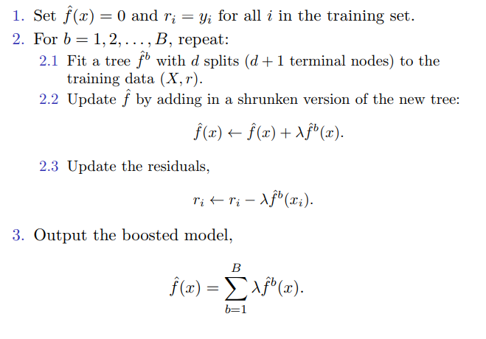
Gradient Boosting

Slide 18
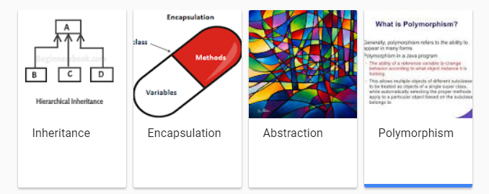
Object-oriented Programming
Class, instance, method
Four pillars in object oriented programming

Slide 19
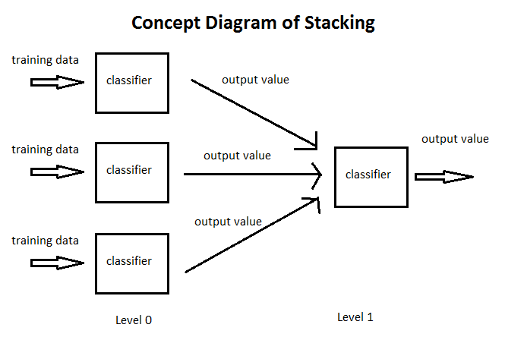
Stacking

Slide 20
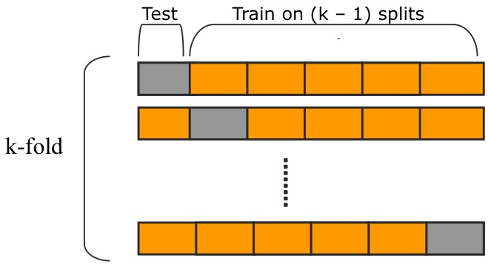
Cross-Validation

Slide 21
Performance Metrics
R2 score
Mean squared error
Mean absolute error
Mean median error

Slide 22
Homework Assignments
Try implementing other machine learning models in Sklearn package on Benz Data Set and interpret the results

